Slide 1
INTERSECT

Slide 2

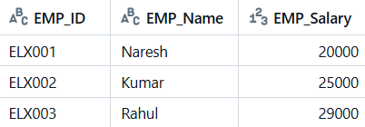
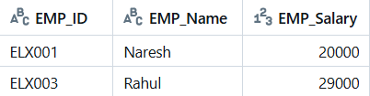
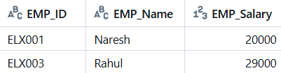
Emp_tbl_design
Emp_tbl_deal

Slide 3
INNER JOIN

Slide 4


Emp_tbl_design
Emp_tbl_deal

Slide 5
IN with Subquery

Slide 6
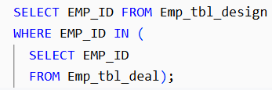
OUTER QUERY
Emp_tbl_deal
Output of INNER QUERY
EMP_ID
ELX001
ELX003
Emp_tbl_design
INNER QUERY
EMP_ID
ELX001
ELX003
ELX001 =
ELX003 =

Slide 7
EXISTS

Slide 8
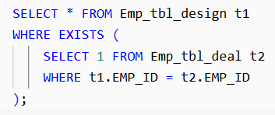
OUTER QUERY
Output of INNER QUERY
Emp_tbl_design
TRUE
Emp_tbl_deal
INNER QUERY
TRUE
ELX001 =
FALSE
ELX001 =
EMP_ID | EMP_Name | EMP_Salary
ELX001 | Naresh | 20000

Slide 9
Emp_tbl_design
FALSE
Emp_tbl_deal
FALSE
ELX002 =
FALSE
ELX002 =
EMP_ID | EMP_Name | EMP_Salary
ELX001 | Naresh | 20000

Slide 10
Emp_tbl_design
TRUE
Emp_tbl_deal
FALSE
ELX003 =
TRUE
ELX003 =
EMP_ID | EMP_Name | EMP_Salary
ELX001 | Naresh | 20000
ELX003 | Rahul | 29000

